Slide 1

Guerrilla Tor
Fun and mayhem for ~ 80 zl

Slide 2

Let’s hide our IP address…
A VPN/proxy implies trust in a third party
Passive adversary can still learn your IP
Tor implies trust in the exit nodes
Setting up your own exit nodes fixes this

Slide 3




Slide 4
Our idea
Set up disposable Tor exit nodes:
It’s our own node, not someone else’s box
Only used a few times, then never again (good OPSEC)
Cannot be traced back to you (no hosting)
Must be cheap
If we were rich we wouldn’t be here, folks!
Must use public internet infrastructure

Slide 5

Can we trust Tor?
Ehrm… no. But we don’t need to:
We control the exit nodes ☺
Using OpenVPN we can thwart existing crypto & traffic analysis attacks against Tor
Time is our ally here
Don’t forget OPSEC

Slide 6
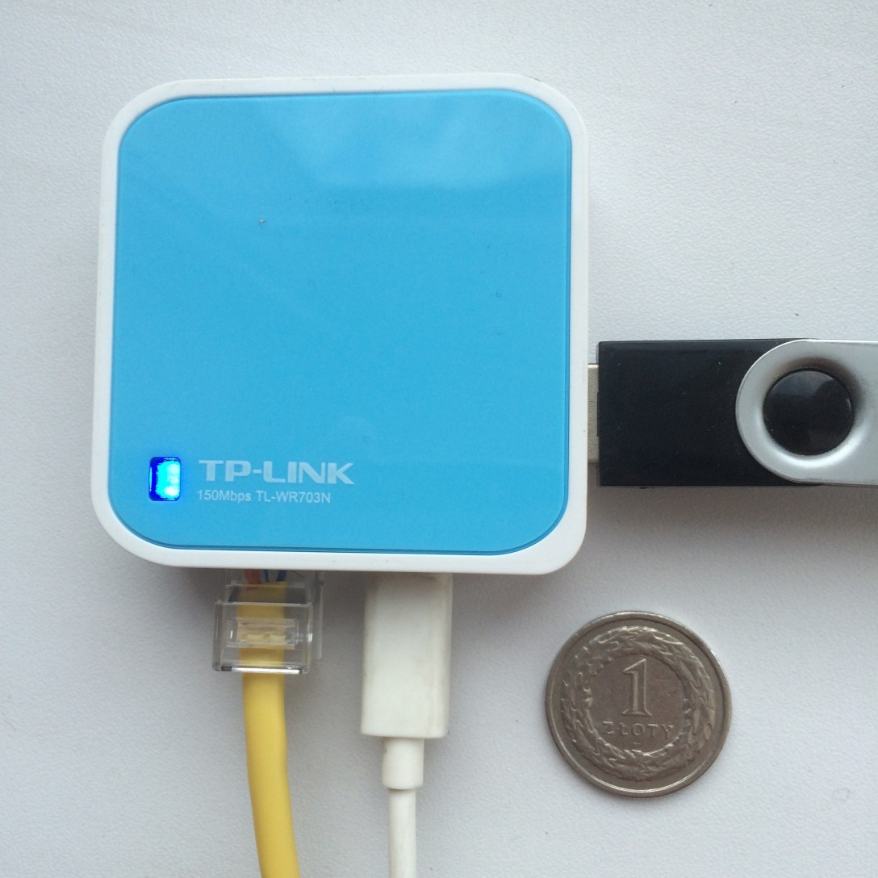
Our first prototype: TL-WR703N

Slide 7
Problems
Somewhat bulky, difficult to hide in public places
Requires external power
Comes with only 8 Mb of ROM
You can fit a minimal build of OpenWRT with Tor, but little else
Requires a USB stick for additional storage

Slide 8
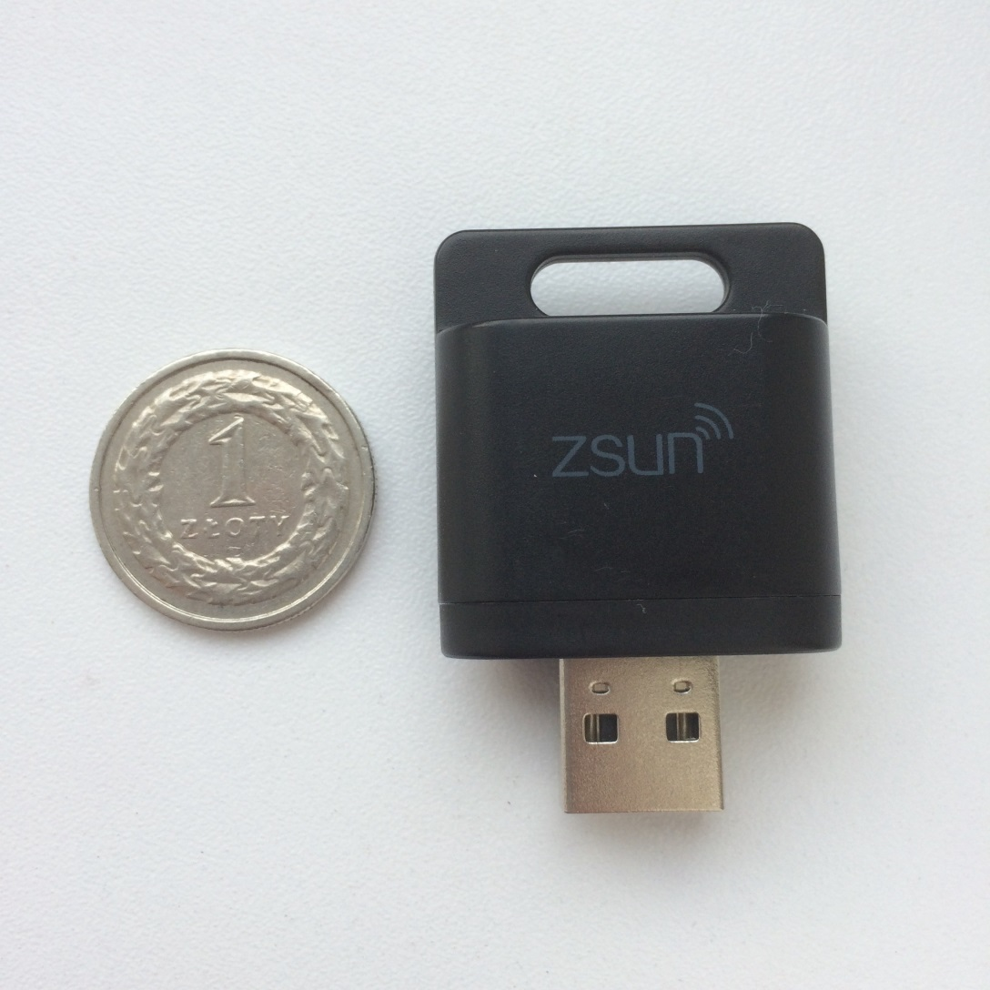
Here comes the ZSUN

Slide 9
Here comes the ZSUN
Even cheaper than the TP-LINK!
Much, much, much smaller
Doubles the RAM and ROM
External storage can be a MicroSD card
Hardware is (relatively) easy to change
Powered from the USB port itself
Already researched at hackerspace.pl

Slide 10


Slide 11


Slide 12


Slide 13
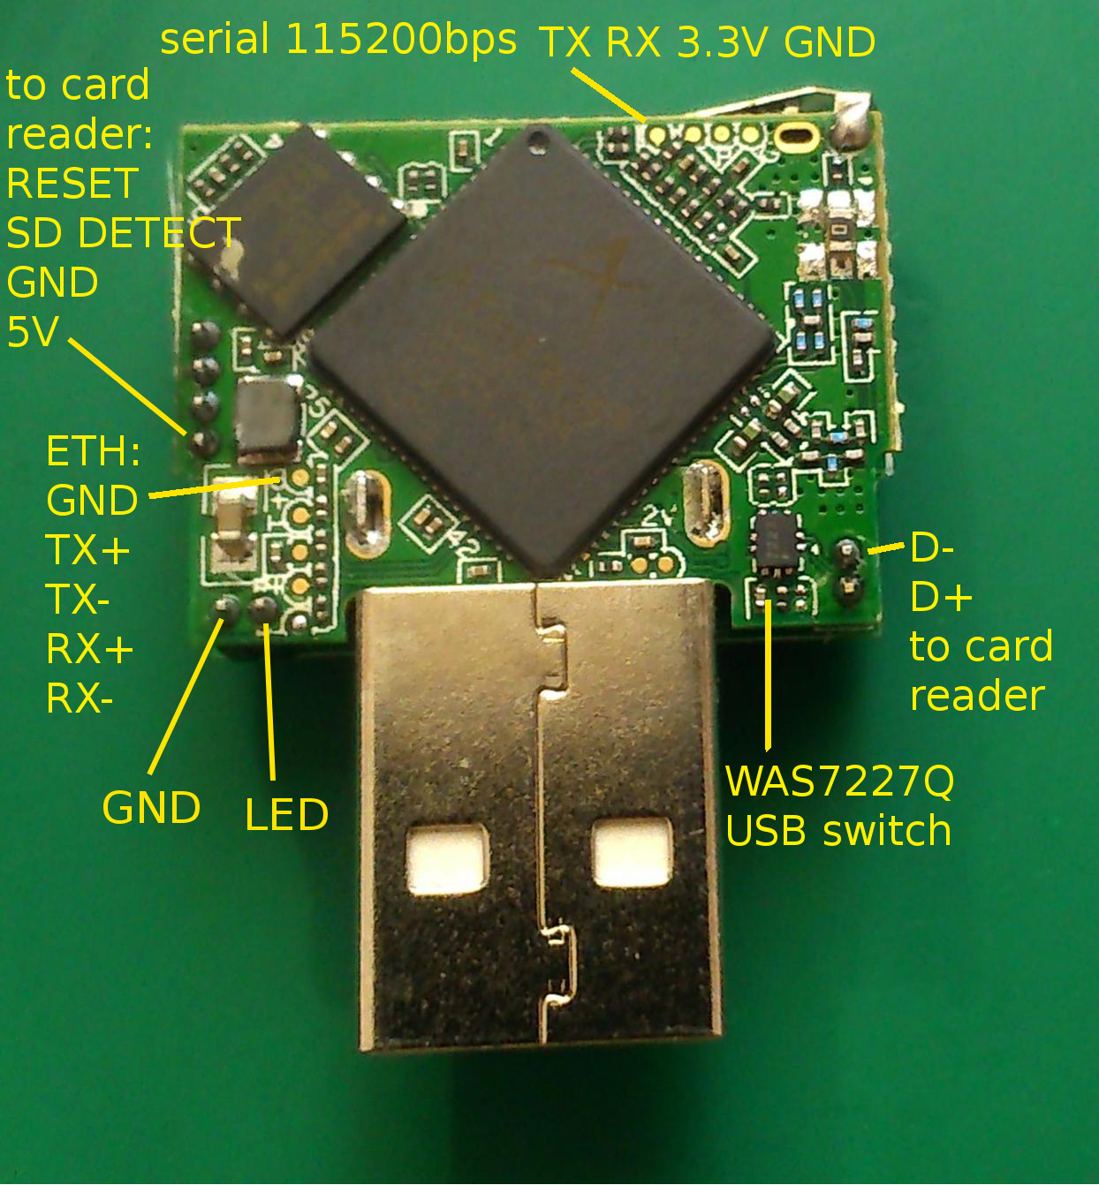
Image credit: https://wiki.hackerspace.pl/projects:zsun-wifi-card-reader

Slide 14
Getting the hardware
We ordered our prototype devices from DealExtreme
This won’t do in real life, cash is better
For bulk purchasing go to the manufacturer
Prices:
~60 zl – ZSUN WiFi SD Card Reader
~40 zl – Waterproof Solar Power Bank
~16 zl – MicroSD & USB Charger
Prices may change in your country! ☹

Slide 15
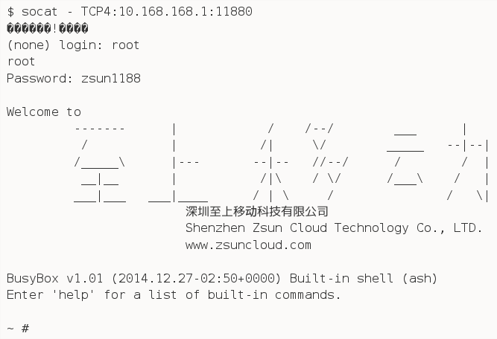
Let’s change the firmware
We’ll miss this beautiful banner though!

Slide 16
Building OpenWRT
The folks at Hackerspace.pl already wrote a kernel patch for this hardware
It’s for an old kernel now, but we ported it to more versions (3.18.29, 4.1, 4.4)
The OpenWRT sources have to be compiled on Ubuntu
We prefer real Linux, thank you :P
Vagrant comes to the rescue!

Slide 17
Building OpenWRT
Using Vagrant, we set up an Ubuntu box
Downloads all dependencies and sources automatically
A Makefile takes care of automating the process of parallel building multiple images
Support for adding patches and additional software and configuration files
SSL/SSH/VPN/Tor certificates generated automatically on each build
Just git clone and you’re good to go

Slide 18
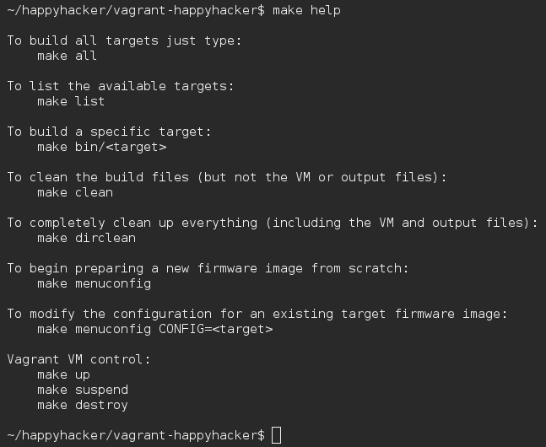
Building OpenWRT

Slide 19
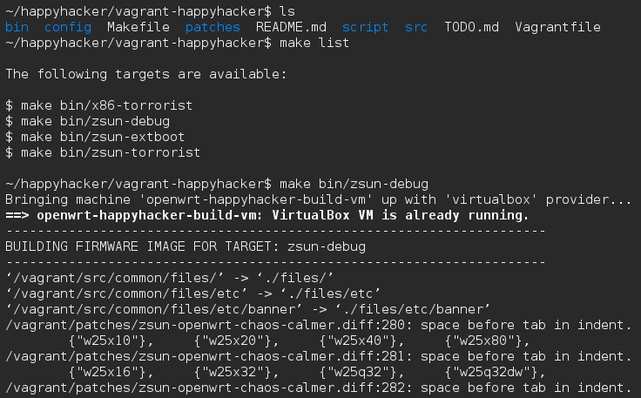
Building OpenWRT

Slide 20
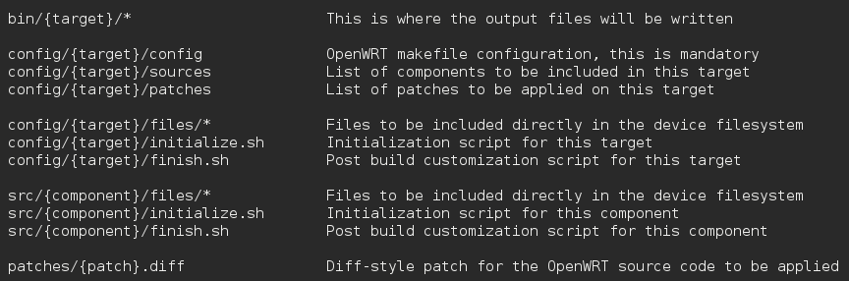
Building OpenWRT

Slide 21
Our setup: ph33r the “torrorist”
Tor configured to act as an exit node, with additional hidden services
OpenVPN for masking our own traffic
Optional applications can be added
A file sharing application to act as an anonymous dead drop for files
More fun stuff can be added too:
IRC/XMPP servers for chat
Murmur server for voice

Slide 22
Connecting to the Internet
This proved to be the most difficult part
Our first idea: 4G modems
They provide a reasonable speed
Can be deployed almost anywhere
Some countries (like Poland) don’t ask for ID when buying a SIM card
Problem: 4G modems are expensive!
Still doable if you’ve got the cash

Slide 23
Connecting to the Internet
Our evil scheme: public Internet access
Many cities in the world have public WiFi infrastructure
Depending on local legislation, you may get away with using WiFi connections from bars and other publically accessible locations
Technical problem is solved, human problems begin ☹
Consult your local tech lawyer!

Slide 24

Connecting to the Internet

Slide 25
Using the Wi-Fi Manager
We developed our own Wi-Fi manager
Can connect to multiple Wi-Fi networks at the same time
Each connection has a different “identity”, with random realistic hostnames and MAC addresses
Integrates with UCI, the OpenWRT configuration system
Modular and very configurable
But works directly out of the box too

Slide 26
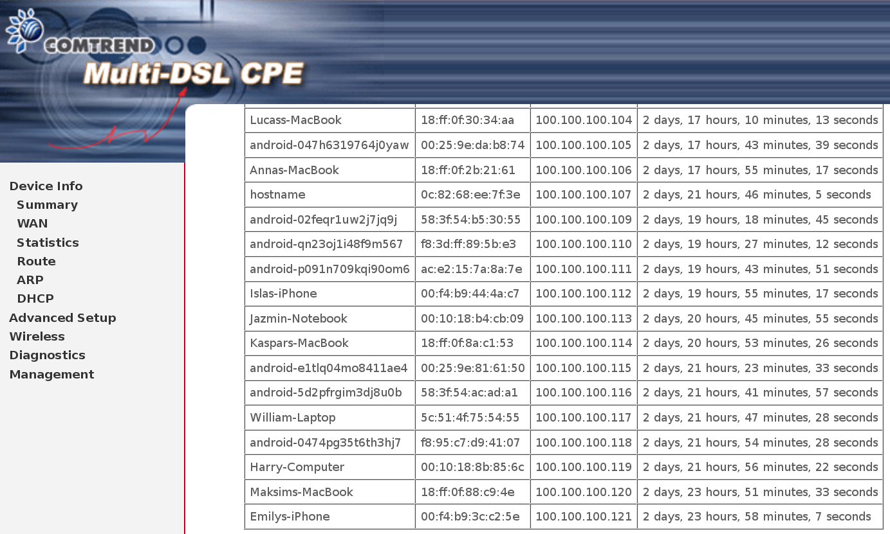
Using the Wi-Fi Manager

Slide 27

Future work
More security improvements are needed
OpenWRT is clearly not designed as a secure environment…
Defaults to building with ALL exploit mitigations turned off
By default everything runs as root

Slide 28
Future work
We’re working on a way to boot OpenWRT directly from the SD card
Not as easy as it seems! We don’t have a helpful BIOS here like we do in x86 ☹
Re-mouting rootfs and loading a new kernel using kexec seems like the way to go, but there are still some problems to solve
The advantage for the end user: no need to flash a new image, just change the SD card

Slide 29
Future work
Another evil plan: using LXC
Containers are handy for isolating the different services running on the device
Deploying containers remotely over Tor is also a possibility
Everything would be volatile – shutting down the device would destroy all data
Think of a guerrilla cloud environment ☺

Slide 30

Thanks for all the fish!

